Slide 1
Lecture 14: Bagging & Boosting

Slide 2
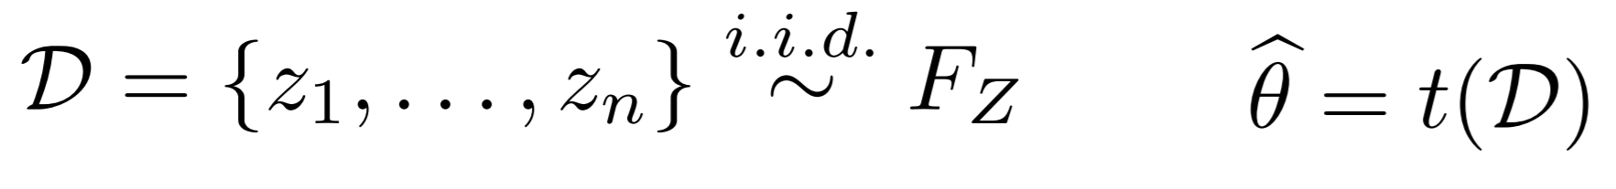
Bootstrapping
Given a set of data that are independent and identically distributed (i.i.d.) samples, D = {Z₁, Z₂,…Z_{n}}, we want to compute θ
For b=1, 2,…B, we define the bth bootstrapped dataset as drawing n samples with replacement from D

Slide 3
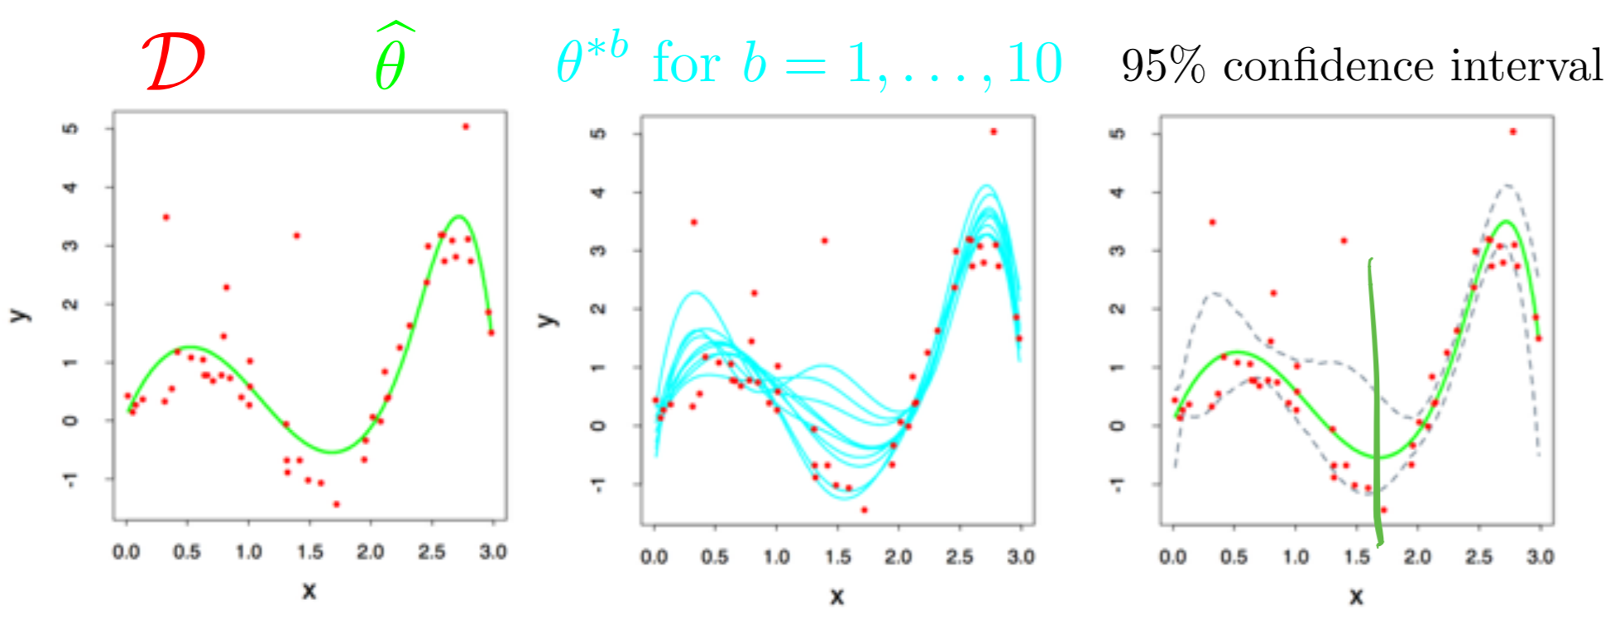
Bootstrap applications
Common applications of the bootstrap:
  Estimate parameters that escape simple analysis like the variance or median of an estimate
  Confidence intervals
  Estimates of error for a particular example:

Slide 4
Bootstrapping vs k-fold cross validation
Bootstrapping is effectively randomly sampling with replacement, while in k-fold cross validation everyone gets a turn as part of a validation dataset

Slide 5
Bootstrap takeaways
Advantages:
  Bootstrap is very generally applicable. Build a confidence interval around anything
  Very simple to use
  Appears to give meaningful results even when the amount of data is very small
  Very strong asymptotic theory (as num examples goes to infinity)

Slide 6
Bootstrap takeaways
Disadvantages:
  Very few meaningful finite-sample guarantees
  Potentially computationally intensive
  Reliability relies on test statistic and rate of convergence of empirical CDF to true CDF, which is unknown
  Poor performance on “extreme statistics” (e.g., the max)

Slide 7
Bagging
Stands for “bootstrap aggregating”
Works with both classification and regression algorithms
Reduces variances
Helps avoid overfitting
Very often applied to decision tree methods, but generalizable to any method
Is a “model averaging” approach

Slide 8
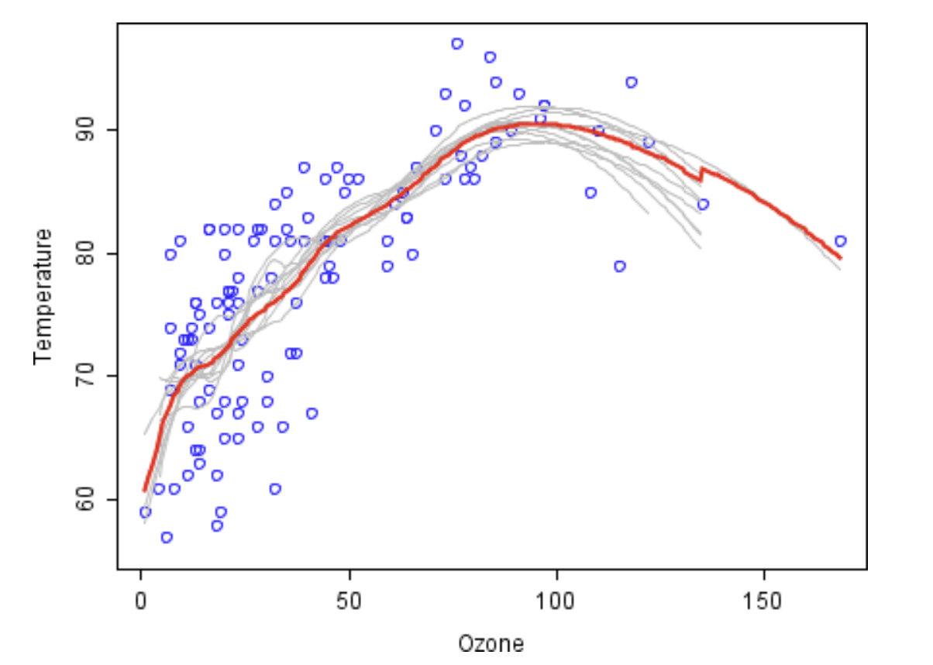
Bagging
Basically, the goal of bagging is to average over many bootstrapped learners to get a more representative fit

Slide 9
Bagging
You’ve essentially already learned bagging!
  Random forests are averages over several decision trees, so essentially an “aggregate” tree
Any time that you can average your learned variables (choice of average is up to you!), you can use bagging

Slide 10
Boosting
Motivated by the question “can a set of weak learners create a single strong learner?”
Similar to, but different from, bagging:
  Bagging averages many low-bias, lightly dependent classifiers to reduce variance (bootstrapping is a low-bias technique for validation)
  Boosting learns linear combinations of high-bias, highly dependent classifiers to reduce error
We will first look at boosting visually

Slide 11
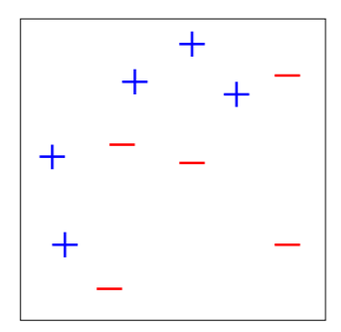
Boosting
Start with 2 features, 10 data points:
  Data clearly not linearly separable
  All data points have equal weight

Slide 12
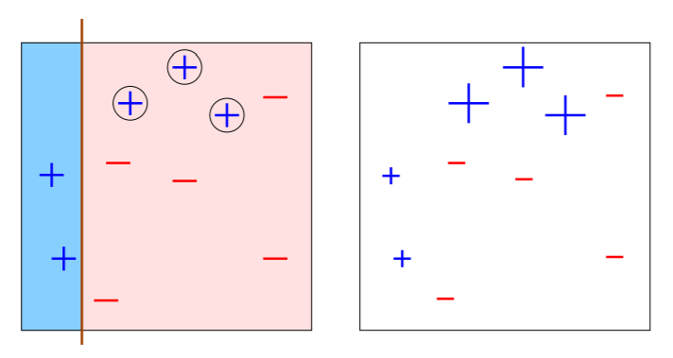
Boosting – step 1
Make a “base classifier” – do the best you can to separate the data with horizontal or vertical lines (“decision stumps”)

Slide 13
Boosting – step 1
3 misclassified points (error 30%) – those receive more/larger/bigger weight (shown here as being larger)

Slide 14
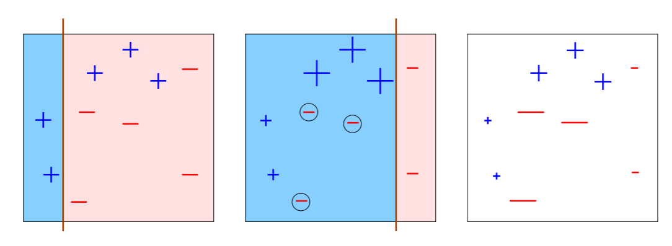
Boosting – step/round 2
3 misclassified points (error is 0.21) – those receive more/larger/bigger weight (shown here as being larger)

Slide 15
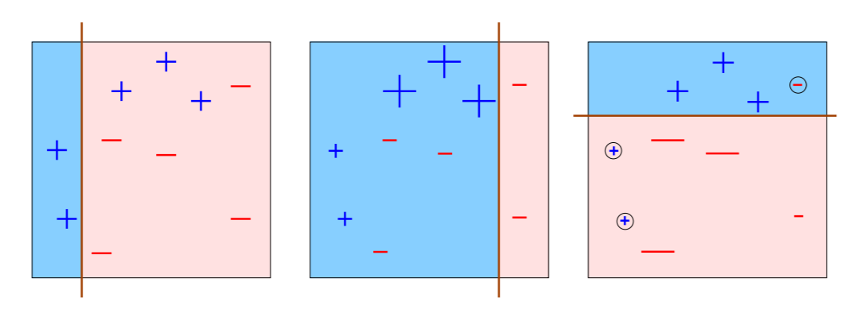
Boosting – step/round 3
3 misclassified points (error is 0.14) – those receive more/larger/bigger weight (shown here as being larger)

Slide 16
Boosting
Since you’ve successfully classified these points before, this round’s mistake will hopefully not majorly impact the overall prediction

Slide 17
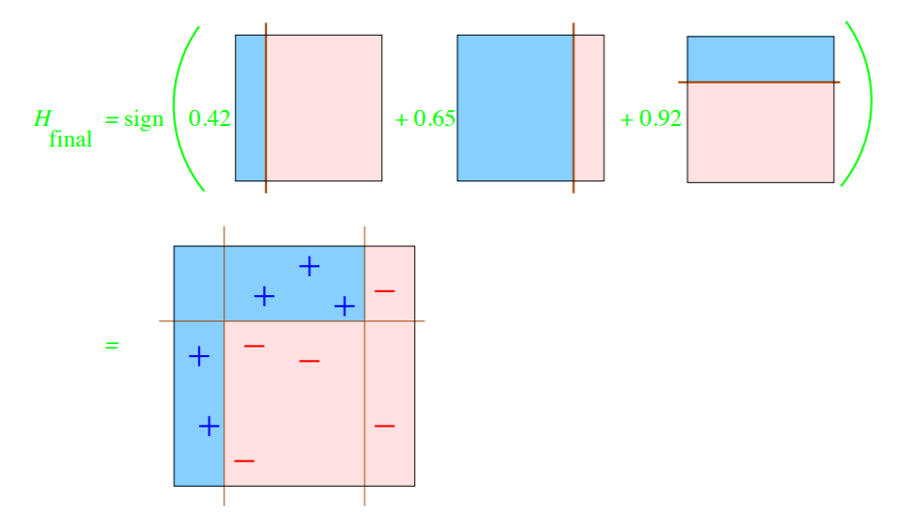
Final classifier

Slide 18
How to decide where to draw lines?
Can we simply enumerate all possible lines? Is that computationally feasible?
  Yes! Can sort data in O(nlogn) time for each feature
  Evaluate thresholds in O(n) time
  Overall, quite fast! Makes it attractive in practice as well as in theory

